Slide 1
Microsoft + Open Source
Dublin OSS Meetup – 21st Feb 2017
Karl Podesta – Cloud Solutions Architect (CSA), Dublin, Ireland
Notes:
Last Updated: 6/30/16

Slide 2

Who is presenting?
Karl Podesta – Cloud Solutions Architect (CSA)
(Started Dec 2016)
Profile: 15 years a Linux guy (+ HPC/Supercomputing, + Open Source Infra)
Roles: Research -> Engineer -> Trainer -> Architect -> Project Manager
Worked: DCU (2yr) -> Securelinx (6yr) -> Tullow Oil (4yr) -> Bloomberg (1yr)
Trainer: Trained 400 people over 4 years (2006-2010)
Architect: Designed a Supercomputer for an Oil Company (+ deployed/operated)
Proj Mgr: Helped deliver “Managed Service” Infrastructure at Bloomberg PolarLake
Techie: Red Hat (7 certs), SUSE (3 certs), LPI/Mellanox/Panasas/TOGAF (1 cert)
Customer work at: Tullow Oil, Bloomberg, Dell, Intel, Bord na Mona, Hickeys Fabrics, Ogilvy, Anglo Irish Bank, Quinn Direct, Teagasc, SFI, UCD, TCD, DCU, UL, UCC, CIT, ITT, Fingal CC, Irish Times, RTE, CRH, O2, Irish Ferries (ICG), Aer Lingus

Slide 3

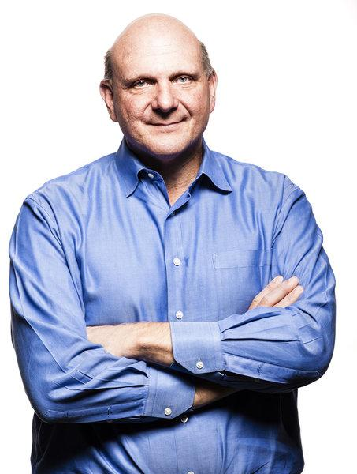
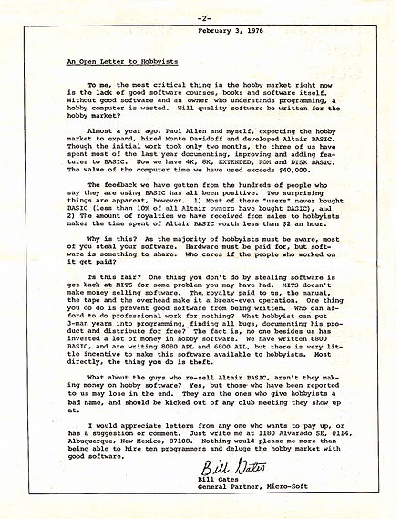
Some Microsoft History with Open Source
Bill Gates – CEO (1975 – 2000)
Steve Ballmer – CEO (2000 – 2014)
A difference in approach…
1976 – “An Open Letter to Hobbyists” against copyright infringement & unauthorized copying of Microsoft software
2008 – “Then Bill Gates stood up.
He walked to the whiteboard and drew a diagram of how the system could work, from copyrights to code contribution to patents, and he said — in no uncertain terms — that the company had to make the move.” - Wired
Some hostility…
2001 – “Linux is a cancer that attaches itself in an intellectual property sense to everything it touches”
Notes:
https://www.wired.com/2012/01/meet-bill-gates/
http://www.theregister.co.uk/2001/06/02/ballmer_linux_is_a_cancer/

Slide 4
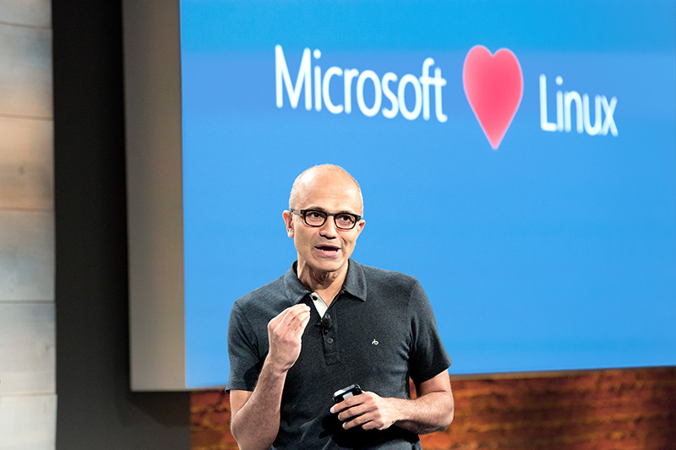
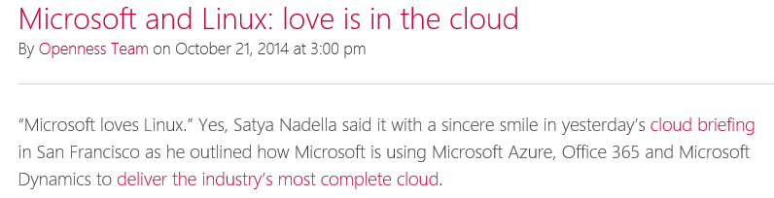
But now… Microsoft loves Linux!
Satya Nadella – CEO (2014 - present)
http://openness.microsoft.com/blog/2014/10/21/microsoft-loves-linux-cloud/

Slide 5
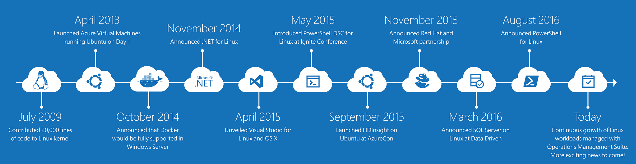
It’s been a journey
PowerShell is now open source and available on Linux
Linux Agent (GA) & Container Solution (Preview) for Operations Management Suite
Hundreds of contributors to the Azure Resource Manager community on GitHub
…and there’s strong momentum for Linux at Microsoft
4x growth in container customers in Azure since January, all with Docker on Linux!
Nearly 1 in 3 VMs in Azure run Linux today
Over 40% of VMs created in new deployments in Azure today run Linux!

Slide 6
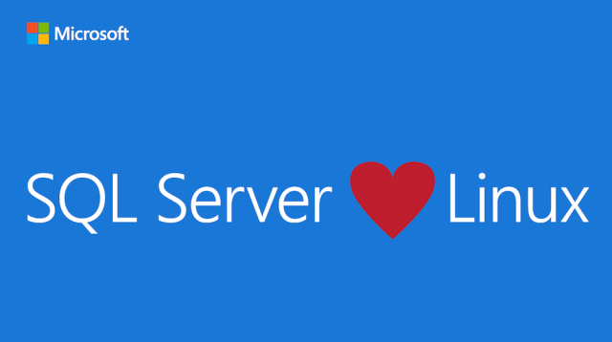

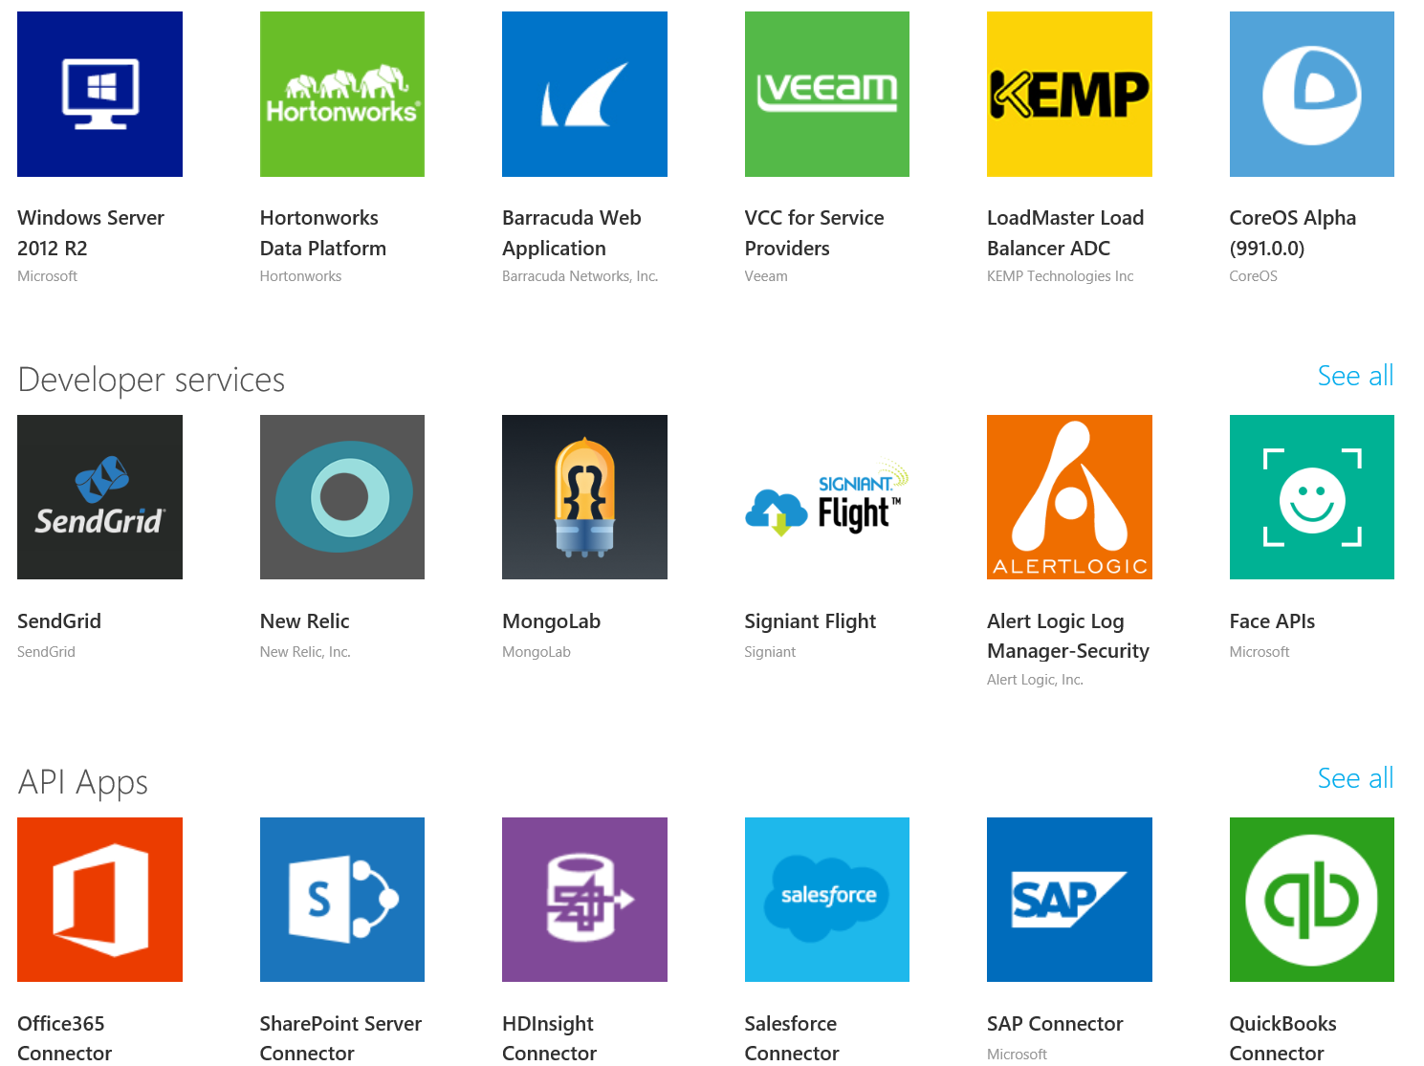


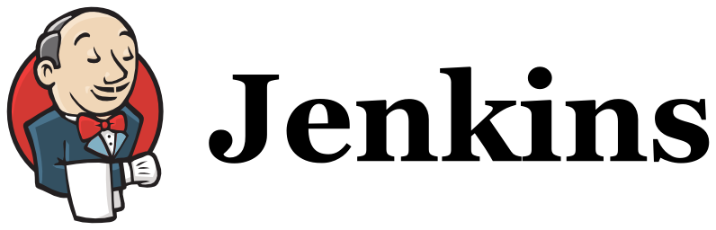

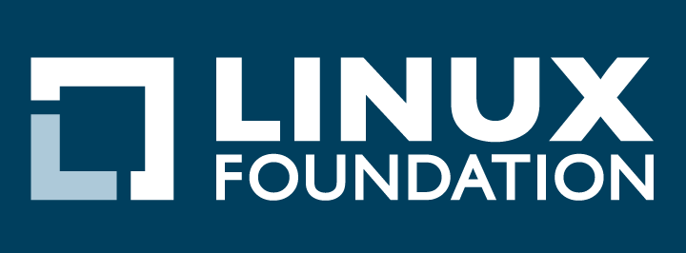

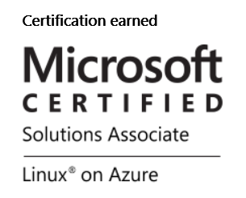
How – Our Open Source Investments are Fueling Momentum
Our Products
Our Offerings
Azure Marketplace
60% of all images in Azure Marketplace are based on Linux/OSS
SQL Server on Linux
Acquisition
Windows Subsystem for Linux
1 out of 3 VMs on Azure run Linux, and more than half of all new VMs run Linux
C:\Users\markhill> bash
1 out of 3
HD Insight managed service on Linux
root@localhost: #
Run Linux on Windows natively
Our Partnerships
Our Employees
Ross Gardler President Apache SW Foundation
Partnership
Jenkins project on Azure
Partnership with the Linux Foundation for Linux on Azure certification
600 Million+
Lines of open source code submitted to GitHub by Microsoft engineers
Microsoft joins Eclipse Foundation
Microsoft Open Source Hub
Notes:
Notes coming soon – please check back on http://aka.ms/opensource for latest version
- We also have an official Open Source policy

Slide 7



















Microsoft Azure is an Open Cloud
Dozens of .NET & PHP CMS and Web applications
Hybrid
Any Application
Any Framework
Enterprise Grade
Hyper Scale
RedHat, Ubuntu, SUSE, OpenSUSE, CentOS & Oracle EL
+ hundreds on VM Depot
Via cross-platform & native code approaches
Any Data
Any Device or Operating System

Slide 8


















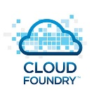























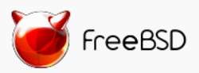
Full Stack in Azure
Clients
Via HTMl/JS, cross-platform and native
Management
Applications /PaaS
Dozens of .NET & PHP CMS and Web applications
App Frameworks
Databases &
Middleware
DocDB
Ubuntu
SUSE, OpenSUSE,
OpenLogic CentOS-based
Oracle Linux, CoreOS
Infrastructure & OS
VM Extensions

Slide 9
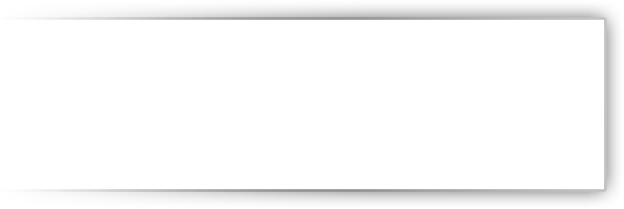






















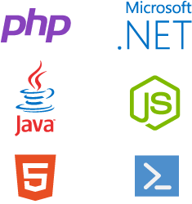







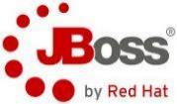




















How: Delivering Open Source Innovation in the Cloud
Addressing Your Enterprise Cloud Needs in a Trustworthy Way
Private Cloud
Hybrid Cloud
Public Cloud
Helping Customers on their journey:
Trust In Microsoft
..... Now Across Your Entire Stack!
Management
System Center
OMS
Team Foundation Services
Enterprise Linux Cloud Infrastructure
DevOps & PaaS
Development & Testing
Applications
Dynamics
SharePoint
Open Source Data Infrastructure
Exchange
Frameworks & Tools
High Performance Computing
.NET
Visual Studio
Java Enterprise Platforms
Data
SQL Server
Web Applications
Infrastructure
Windows
Server
Notes:
Notes coming soon – please check back on http://aka.ms/opensource for latest version

Slide 10













How - Our Approach to Open Source in the Cloud
Enable
Integrate
Release
Participate
Enable Linux and Open Source technology to be first class citizens on Microsoft Platforms
Embrace leading Open Source ecosystems and integrate Microsoft products with agility and consistency
Release key Microsoft technologies into the Open Source domain to build a strong ecosystem
Microsoft engineers to participate in communities and contribute to key Open Source projects
R Server
.NET Core
Roslyn
TypeScript
F#
autorest
PowerBI Visuals
Office UI Fabric
Tools plugins
Open Source Partners & Ecosystem
Notes:
Notes coming soon – please check back on http://aka.ms/opensource for latest version

Slide 11
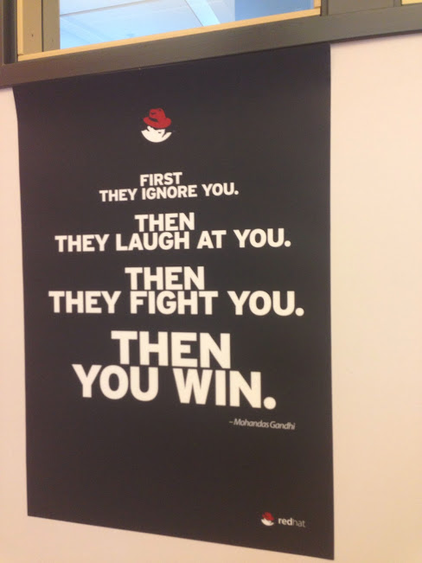
Partners – Red Hat; world’s first $1B Open Source company
Red Hat Training Centre, Stockholm, April 2013
“First they ignore you. Then they laugh at you. Then they fight you. Then you win.” – Gandhi

Slide 12
Partners – Red Hat; world’s first $1B Open Source company
Red Hat Training Centre, Stockholm, April 2013
“First they ignore you. Then they laugh at you. Then they fight you. Then you win.” – Gandhi
… Red Hat are now a Microsoft Partner
“What happens when Red Hat and Microsoft join forces? You win.” – redhat.com, Jan 2017
Integrated Support: Red Hat on-site at Microsoft
(Almost) All Red Hat products now on Azure
Operating System (Linux)
Development/Middleware (JBoss)
Cloud (OpenShift: Docker/Kubernetes)
Migration tools created (Red Hat Cloud Access)
Management tools integrated (Red Hat CloudForms)

Slide 13
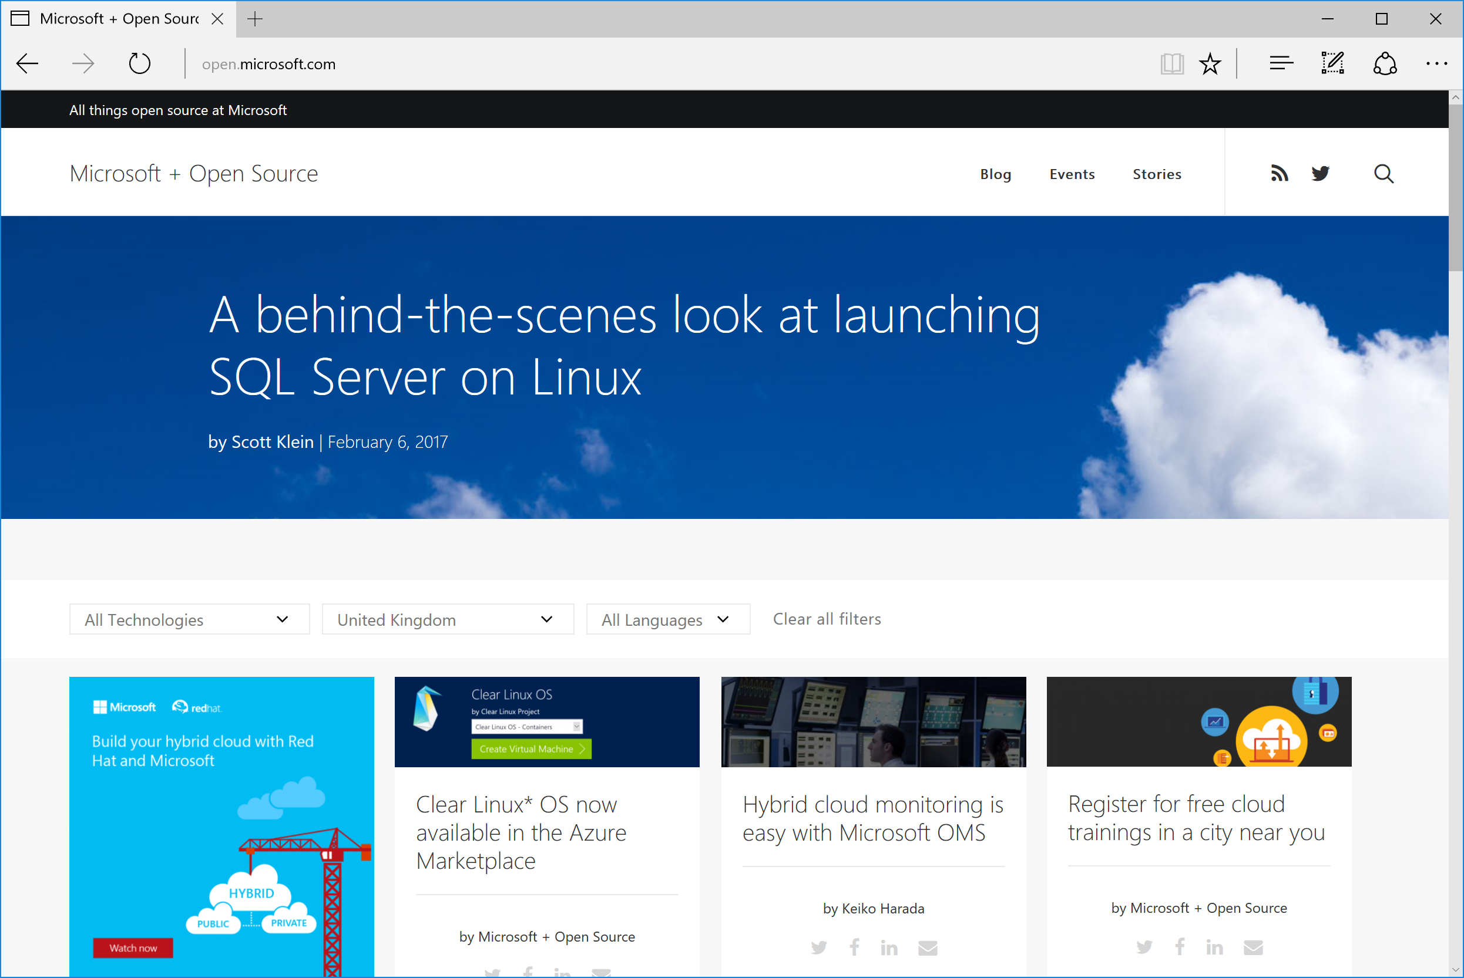
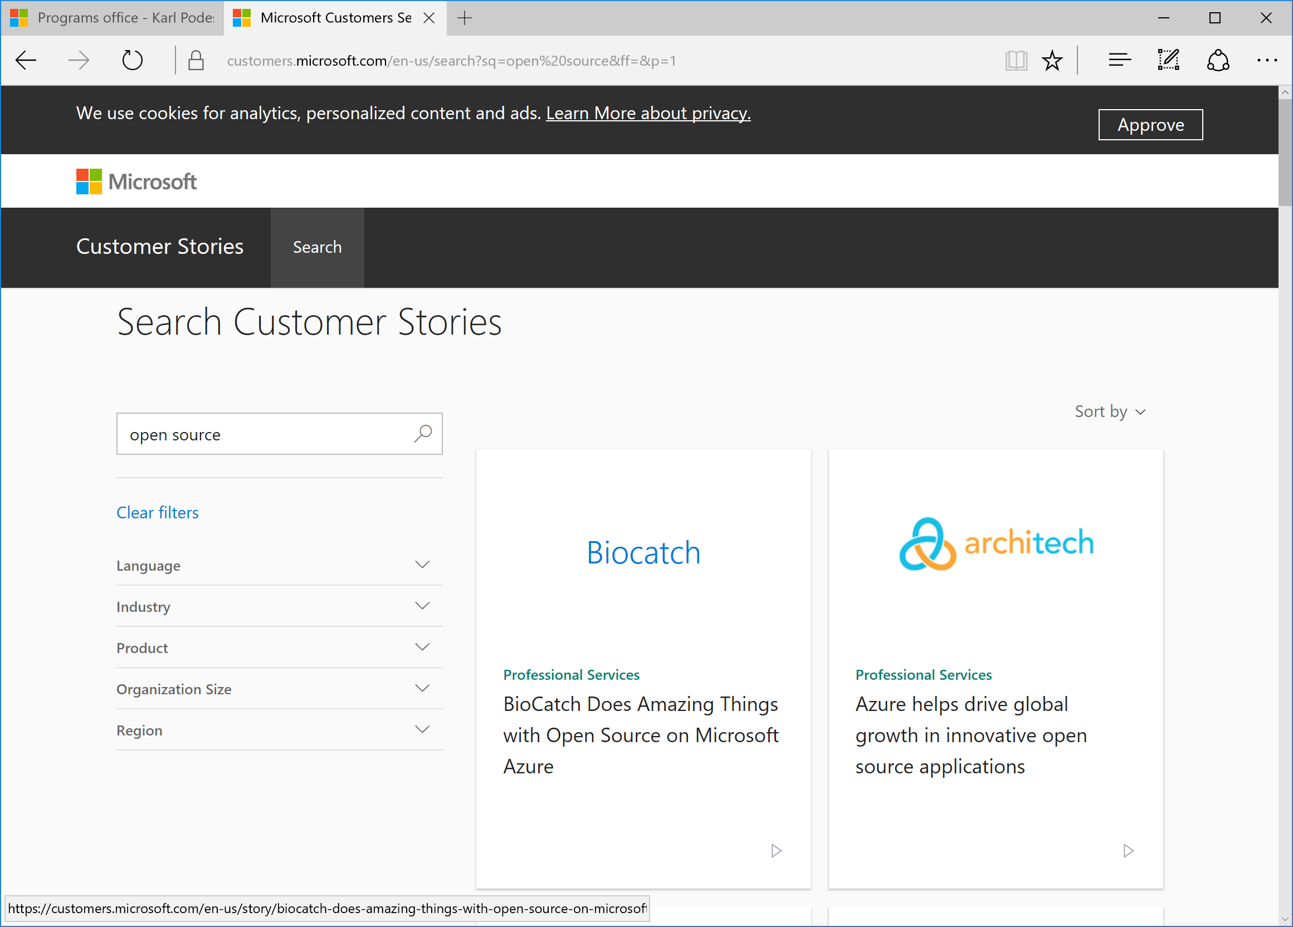
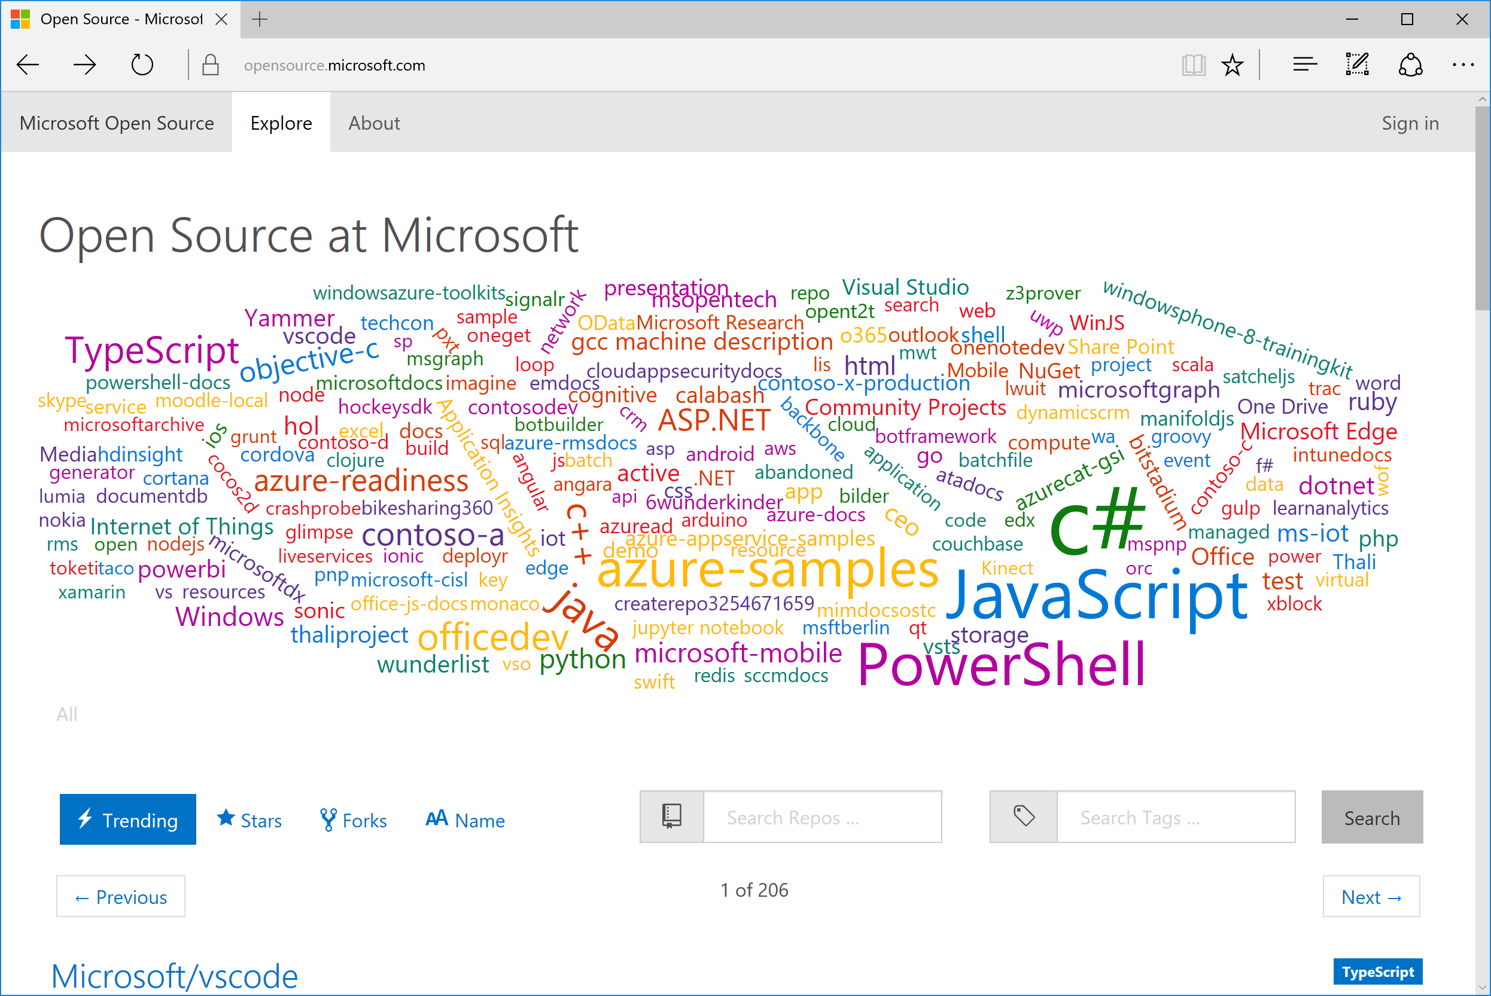
Marketing - http://open.microsoft.com
Customers -
http://customers.microsoft.com
Community -
http://opensource.microsoft.com

Slide 14
Open Source + Open Initiatives
Open Source Program Office
- Consume / Contribute / Create / Collaborate
Change Culture – permeate design, engineering, product, customer interaction
https://opensource.microsoft.com/resources/office
Microsoft is part of:
Open Science Movement
Open Compute Project
Open Container Project
Other items:
This week Microsoft Open-Sourced it’s drone simulator
How Microsoft came around to Open Source (from newstack.io):
https://thenewstack.io/microsoft-finally-came-around-open-source/

Slide 15
Resources – Open Source on Azure
All things Open Source at Microsoft
http://open.microsoft.com/
Search our Customer Stories for e.g. “Open Source” or “Linux”
https://customers.microsoft.com
Open Source Development for Microsoft Engineers
https://opensource.microsoft.com/

